Slide 1
Cookbook for Practice 2.5
实践2.5攻略
Cong Li 李聪

Slide 2

Basic Settings 基本设置
Duplicate ‘single.cpp’ as ‘simple.cpp’
将’single.cpp’复制为’simple.cpp’
Add an additional constant definition
增加一个常量定义

Slide 3

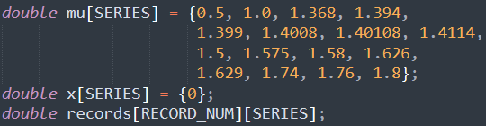
Initialization 初始化
Change the initialization from single-number variables
将初始化中的单数值变量
to multiple-number array
改为多数值数组

Slide 4
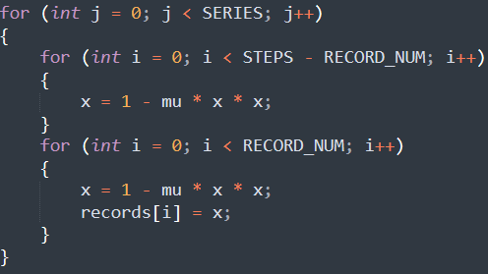
Calculation & Recording
计算与记录 (1)
Put the calculation & recording into an outer loop w/ indent
将计算与记录缩进并放入一个外重循环中

Slide 5
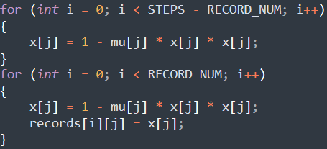
Calculation & Recording
计算与记录 (2)
Add the additional indices to the variables in calculation & recording 在计算和记录时，为变量加入额外的下标

Slide 6
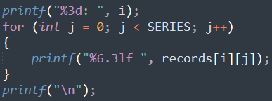
Results 结果
Change the record output from single number per line
将记录输出从一行单个数
to multiple numbers per line
改为一行多个数
Compile & run it 编译并运行之
mingw32-make SRC=simple.cpp
run-simple.exe

Slide 7
The End

